Slide 1

Café marvelous

Slide 2
Acknowledgement
This project was an ambitious work and would have never been completed without the facilities provided by the ma’am and the sincere efforts of my faculty colleagues guided me helped this project.
My sincere “THANKS” goes to:
I want to express my gratitude and sincere thanks to our Faculty and HOD of dept. Mrs. Chitra Nagarkar for providing better working environment for competing this project successfully.
Lastly my thanks to my subject teachers and all my friends for inspiring my spirit to achieve this target.
Ritesh More
Roll no :- 15465
Harsh Harke
Roll no :- 15443
Gaurav Pardeshi
Roll No : 15456
Master of Computer Science.

Slide 3
Introduction
As the name suggests " Café Management System" is a platform for users to manage, sort and keep the stock of Food items updated in the cafe we felt the need to develop this system. Because if things are not organized properly it quickly becomes finding a needle in a haystack and all things may collapse.

Slide 4
Existing systems
Existing systems are more expensive than traditional case registers and are not specifically designed for cafes. So they do provide some features and functionality but not all which are required for managing a cafe efficiently .
As they are more expensive they are not a economically viable option. So cafe owners use registers books and all manual ways to manage the accounts and activities which harm the business. Existing systems are bug prone.

Slide 5
Scope of the System
They are not designed specifically for cafes and if they are then analysis quite expensive so the large number of cafe owners don’t use them.
Existing systems can be used to do managing tracking updating items in cafe .
Project perspective features:
Economically viable option
Easy to use
Bug free
Give valuable insights

Slide 6
Feature of the system
Add order: Manage orders for multiple tables simultaneously, improving efficiency during peak hours. A user-friendly interface lets staff quickly add items to orders.
Manage order: Update menus in real-time to reflect ingredient availability, daily specials, or price changes. This eliminates confusion for both staff and customers.
Add Product: The "Add Order" function is the heart of your cafe management system. It allows you to efficiently capture customer selections and streamline the ordering process.
User Notification: Receive instant notifications on low stock, completed orders, upcoming deliveries, and more. This allows for proactive inventory replenishment and timely order fulfillment.
Social media notice: The "Add Order" function is the heart of your cafe management system. It allows you to efficiently capture customer selections and streamline the ordering process.
Dish Recommendations: Our web app might recommend a chilled beverage made with mango pulp, milk, and ice cream. Sujata Mastani and The Cold Drink House are popular choices.
Language Translation: Integration with language translation tools to help travelers communicate more effectively in foreign countries where they may not speak the local language.
User Reviews and Ratings: Access to user-generated reviews and ratings for destinations, accommodations, and activities to help users make informed decisions.

Slide 7
System requirement
SOFTWARE
Front End :- CSS -3, Bootstrap, HTML-5, JavaScript
Back End :- PHP
Database :- MySQL
Code Editor :- VS Code
Operating System `:- Windows
HARDWARE
Processer: i3 and above
RAM: 1GB or Higher
Hard Disk: 128GB

Slide 8
Feasibility Study
Feasibility study is conducted to determine if the project, upon completion, will serve the purpose of the organization considering the amount of work, effort, and time invested in it. It allows developers to foresee the future of the project and its usefulness. A feasibility study of a system proposal is conducted based on its workability, impact on the organization, ability to meet user needs, and effective use of resources. Therefore, when a new application is proposed, it typically undergoes a feasibility study before being approved for development.
The document provides the feasibility of the project being designed and lists various areas carefully considered during the feasibility study, such as Technical, Economic, and Operational feasibilities. The following are its features:
Technical Feasibility: The system must be evaluated from a technical perspective first. The assessment of this feasibility must be based on an outline design of the system requirements in terms of input, output, programs, and procedures. Having identified an outline system, the investigation must go on to suggest the type of equipment required and the method of developing and running the system once it has been designed. Technical issues raised during the investigation include:
Does the existing technology suffice for the suggested one?
Can the system expand if developed? The project should be developed in such a way that the necessary functions and performance are achieved within the constraints. The project is developed using the latest technology. Though the technology may become obsolete after some time, due to the fact that newer versions of the same software support older versions, the system may still be used. So, there are minimal constraints involved with this project. The system has been developed using Java, making the project technically feasible for development.

Slide 9
Economic Feasibility: The developing system must be justified by cost and benefit. Criteria ensure that effort is concentrated on projects that will give the best return at the earliest. One of the factors affecting the development of a new system is the cost it would require. Some of the important financial questions asked during the preliminary investigation include:
The costs to conduct a full system investigation.
The cost of hardware and software.
The benefits in the form of reduced costs or fewer costly errors. Since the system is developed as part of project work, there is no manual cost to spend on the proposed system. Also, all the resources are already available, indicating that the system is economically feasible for development.
Operational Feasibility: Operational feasibility evaluates whether the proposed system will be able to operate smoothly within the organization's existing processes and procedures. It assesses factors such as user acceptance, ease of integration with existing systems, and the availability of necessary resources for system implementation and maintenance. Operational issues raised during the investigation include:
Will users be able to adapt to the new system easily?
Can the system be integrated seamlessly into existing workflows?
Are the required resources, such as personnel and training, available for system implementation and maintenance? By addressing these operational concerns, the feasibility study ensures that the proposed system will be practical and beneficial for the organization's operations."

Slide 10
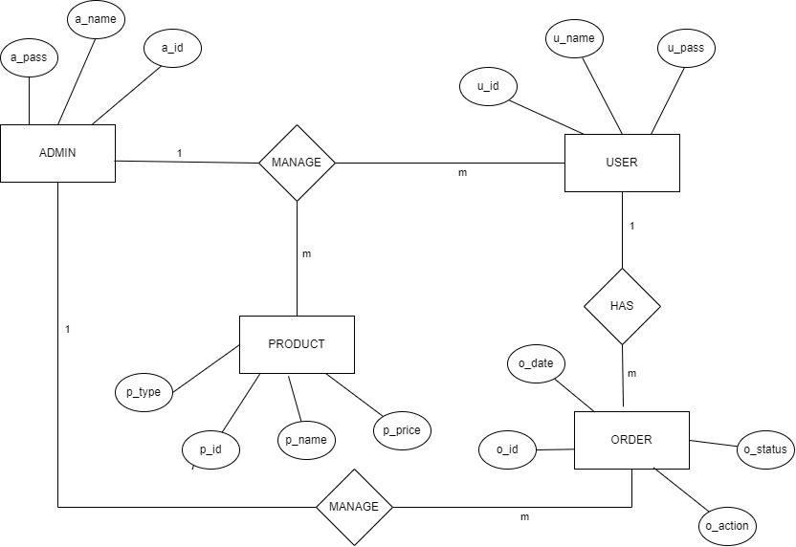
Entity-Relationship diagram

Slide 11
Class diagram
Admin
+Name
+Email_ID
+Password
+Phone_No
+insert()
+update()
+delete()
+view()
+edit()
Order
User
Product
+Product_category
+Product_quantity
+Order_time
+Order_price
+Customer_ID
+Customer_Name
+Email_ID
+Phone_No
+Product_ID
+Product_Name
+Product_Price
+Product_quantity
+view()
+insert()
+update()
+delete()
+insert()
+update()
+delete()
+insert()
+update()
+delete()

Slide 12
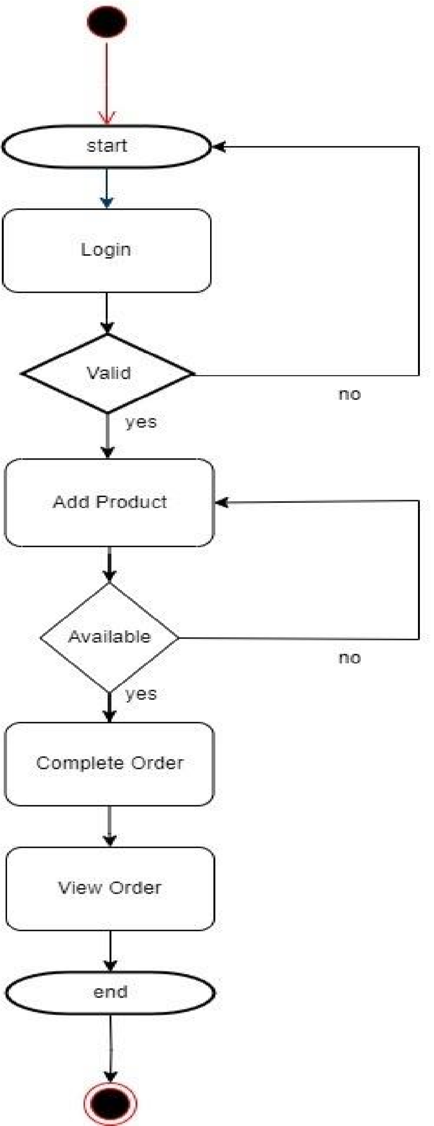
Activity Diagram

Slide 13
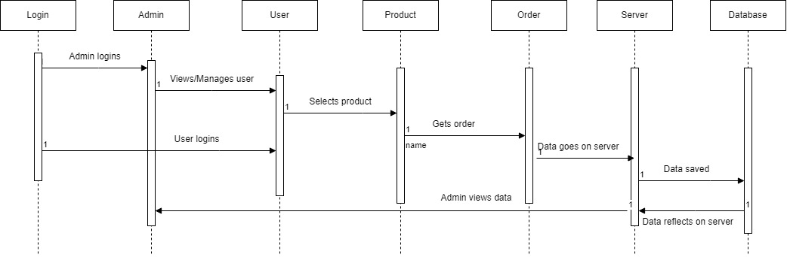
UML:Sequence diagram

Slide 14
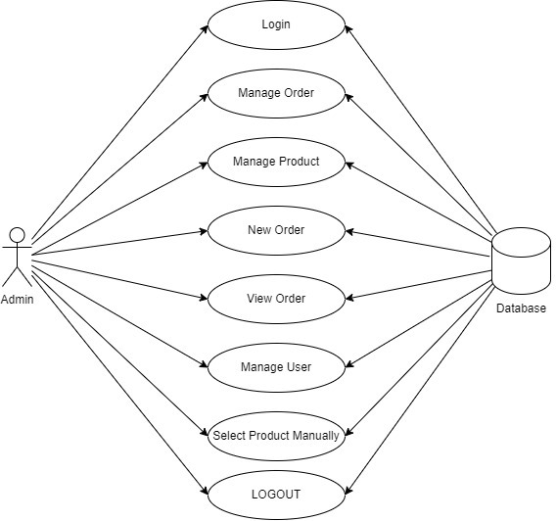
Use case Diagram
Admin- use case :

Slide 15
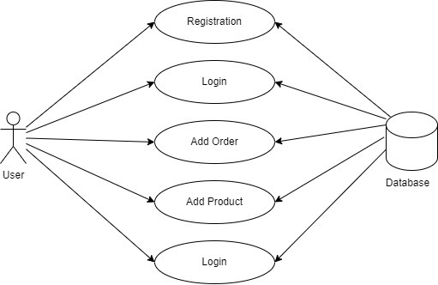
User-use case

Slide 16
Data dictionary
Column | Data types
name | String
email | String
Id | int
Product name | String
Password | int
price | Int
Note | String

Slide 17
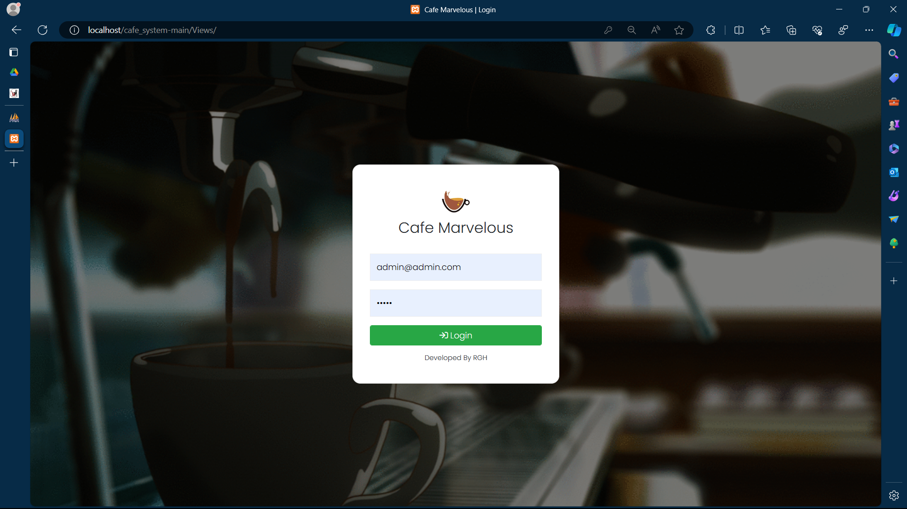
Input output screen
Admin login

Slide 18
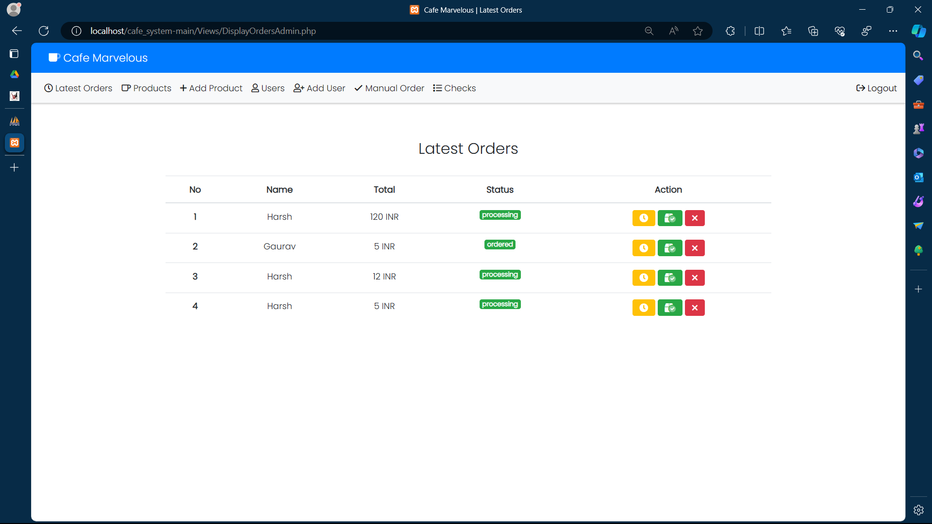
Latest order-

Slide 19
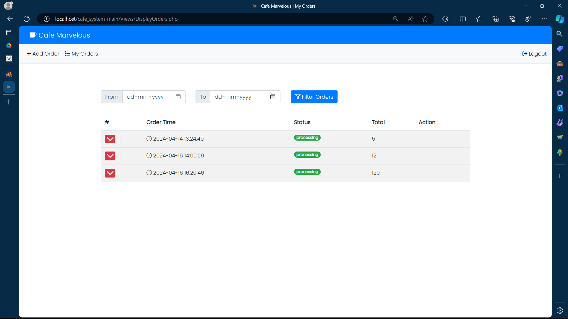
Display order

Slide 20
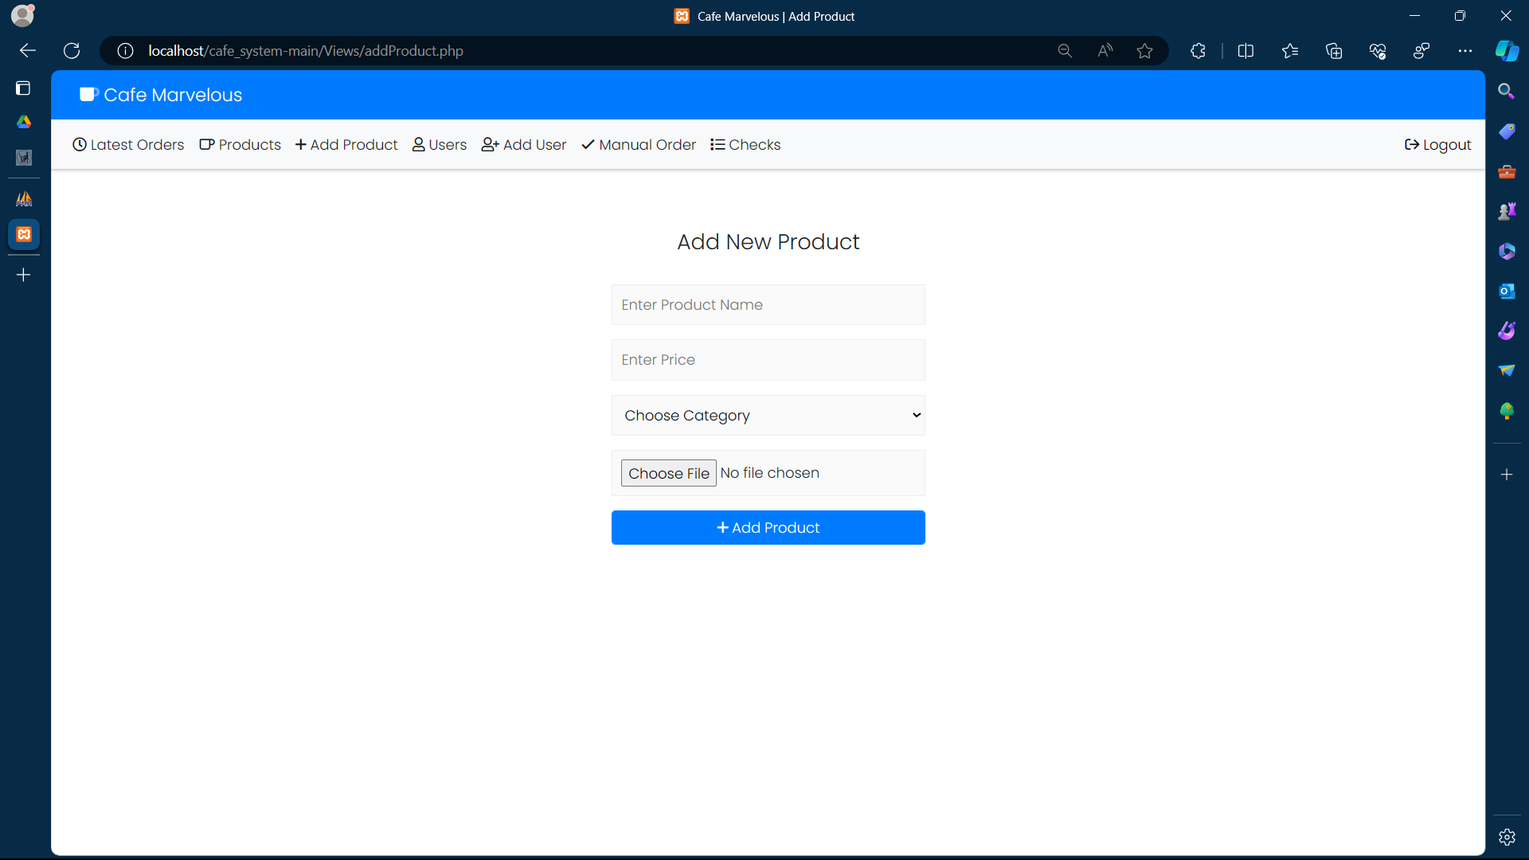
Add product

Slide 21
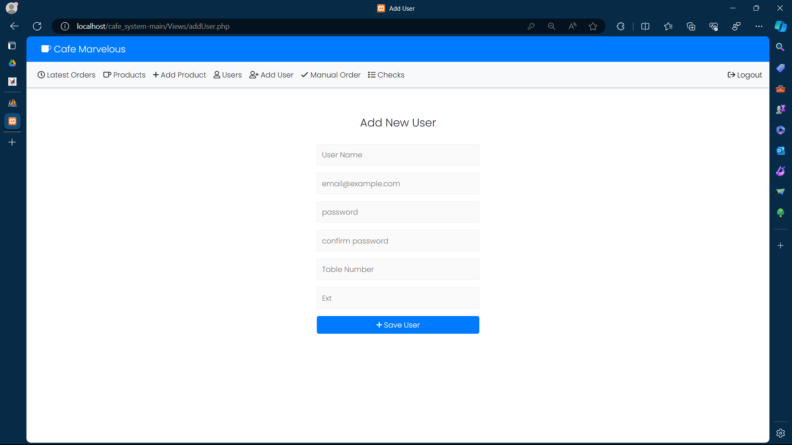
Add new user

Slide 22
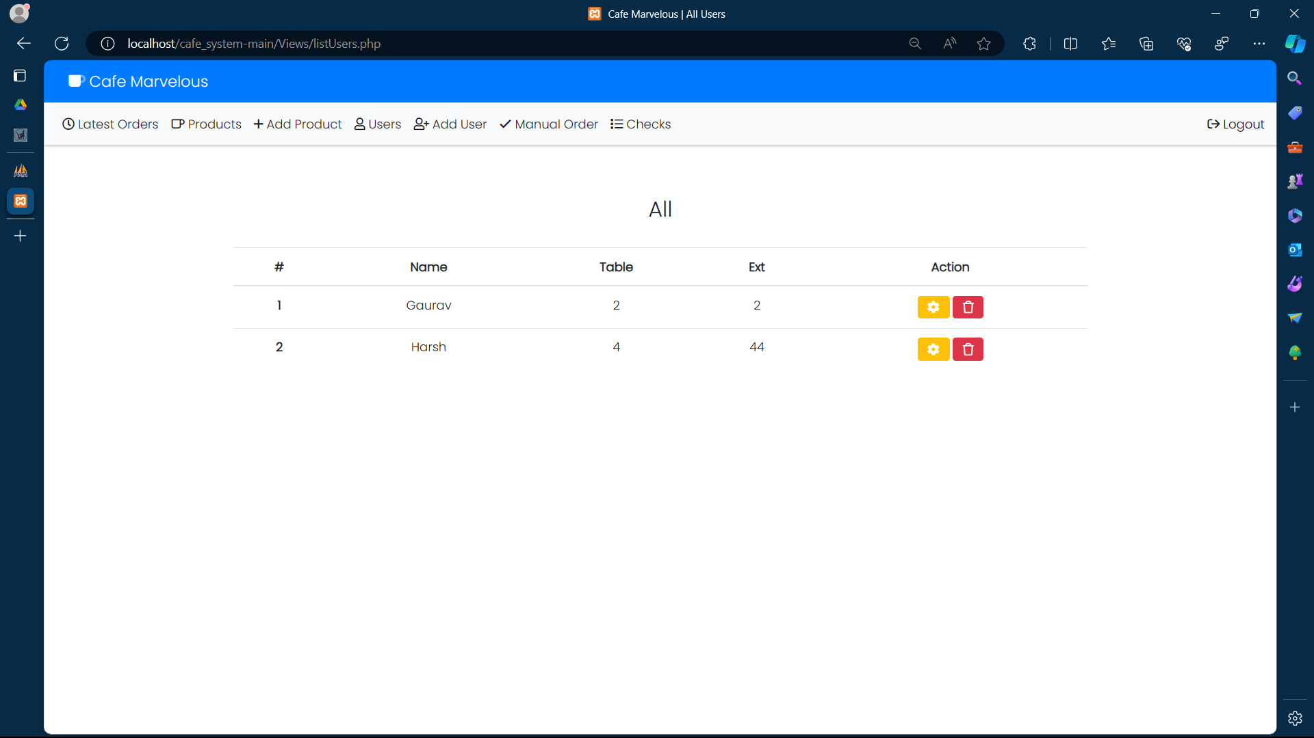
User’s

Slide 23
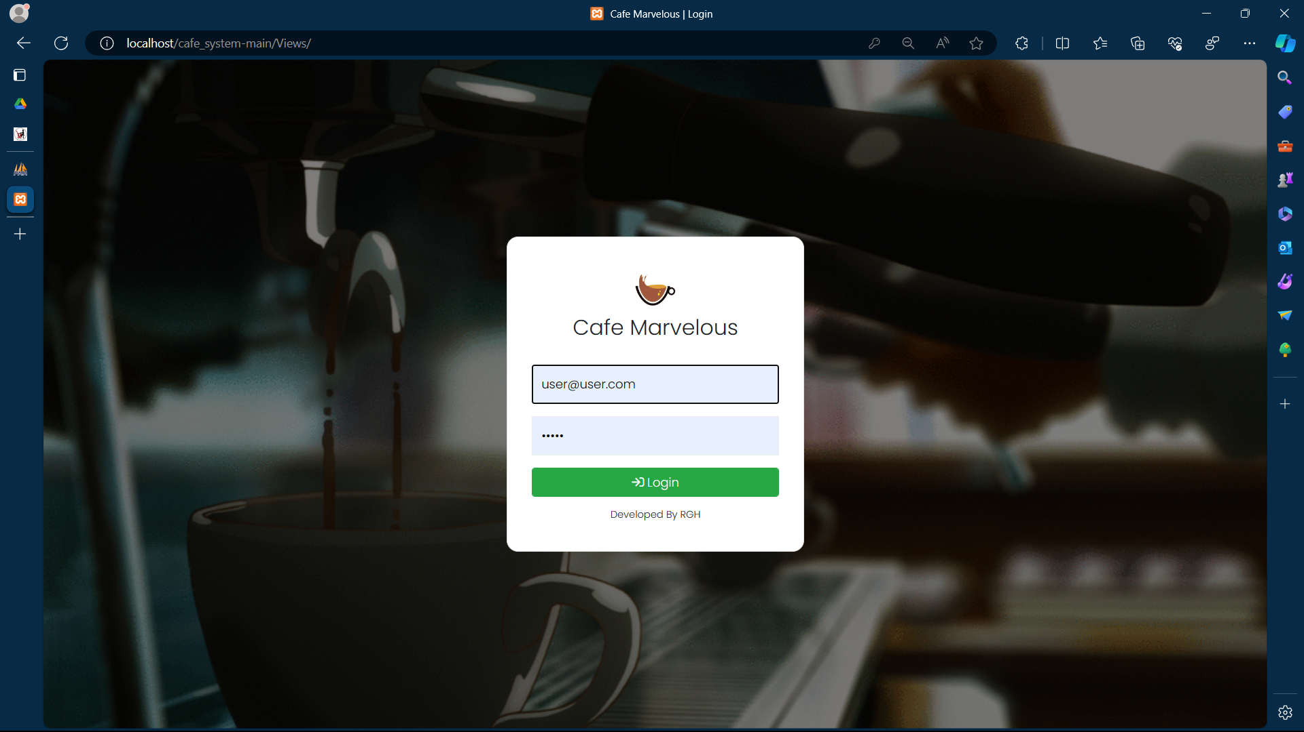
User login

Slide 24
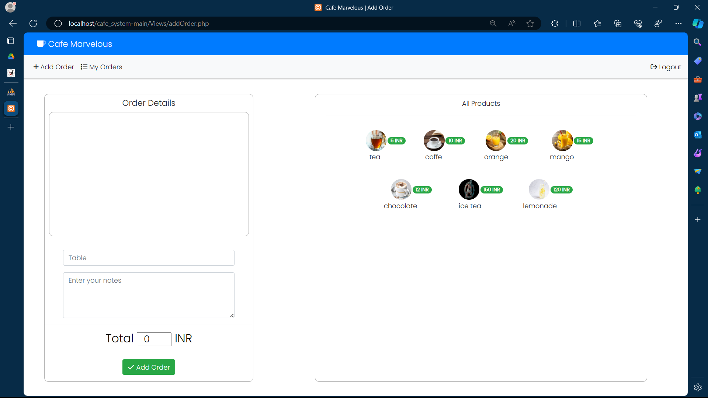
Add order

Slide 25
Conclusions
The conclusion of a Café Management System project could involve summarizing the key findings, discussing any challenges faced during the project, reflecting on the overall success or areas for improvement, and outlining potential future enhancements or developments for the platform.
It's also important to acknowledge the contributions of team members and stakeholders and express gratitude for their efforts in bringing the project to fruition.
Additionally, highlighting any lessons learned or insights gained from the project can provide valuable takeaways for future endeavours.

